Slide 1
CSC111
Introduction to Computer Science
Course Instructors:
Prof. B. S. Aribisala
Dr. U. C. Ogude
Department of Computer Science
Lagos State of University

Slide 2
Introduction to Software and Programming Languages
System Software
Operating Systems
Types of Operating Systems
Language Translators
Utility Software
Application Software
Word Processing Packages
Spread sheet Packages
Graphic Packages
Database Packages
Computer Languages
Machine Languages
Low-Level Languages
High-Level Languages
Desktop Publishing Packages
Games Packages
Communication Packages
User Programs
Integrated Packages

Slide 3
Computer Software
Computer software is the set of programs that makes the hardware perform a set of tasks in particular order.
Hardware and software are complimentary to each other. Both have to work together to produce meaningful results.
Computer software is classified into two broad categories;
System Software and
Application Software.

Slide 4
A Layered View of the Computer
Hardware/Software interface
Application Programs
Word-Processors, Spreadsheets,
Database Software, IDEs,
etc…
System Software
Compilers, Interpreters,Preprocessors, etc.
Operating System, Device Drivers
Machine with all its hardware

Slide 5
Systems Software
  Set of programs that coordinates activities and functions of the hardware and various other programs.
The software that controls everything that happens in a computer.
Background software, manages the computer’s internal resources
  Programs written for computer systems
    Compilers, operating systems, …
System software consists of a group of programs that control the operations of a computer equipment including functions
managing memory,
managing peripherals,
loading, storing,
an interface between the application programs and the computer.

Slide 6
MS DOS (Microsoft’s Disk Operating System), UNIX are examples of system software
System Software manages the fundamental operations of your computer
  Operating system
    System resource
    Multitasking
  Utilities
  Programming Languages

Slide 7
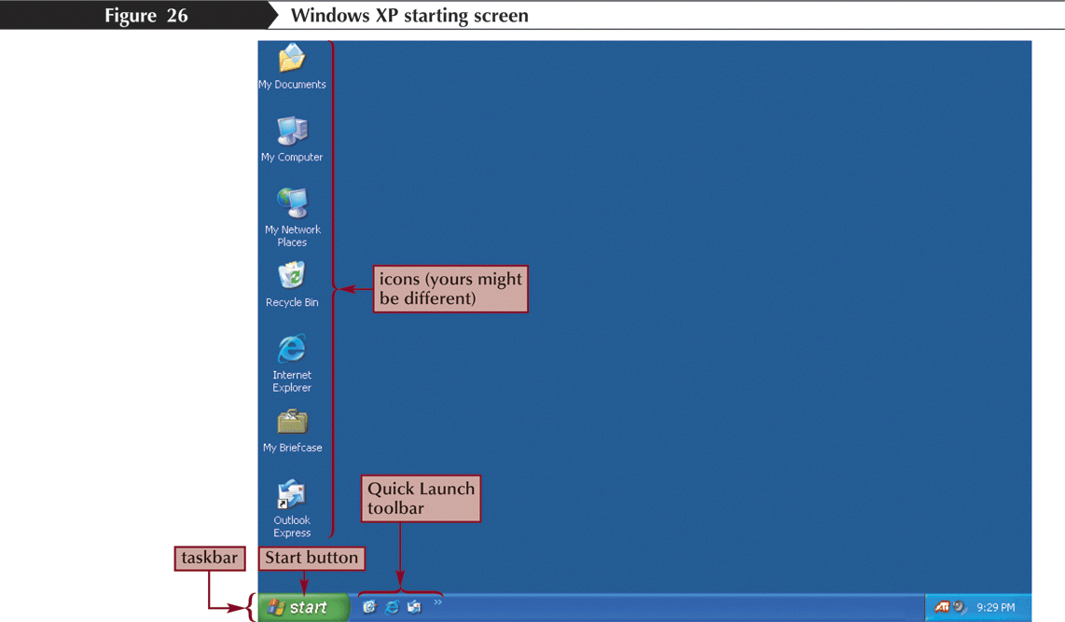

Slide 8
Operating Systems or OS
The operating system (OS) controls all other software and allows the hardware devices to work properly.
Without an operating system, a user cannot run an application program on their computer, unless the application program is self booting.
Some popular operating systems are:
  Microsoft Windows - for PCs
  Mac OS - for Apple computers
  Linux - for very large network computers
  Handheld operating systems - for PDAs, MP3 players, and cell phones

Slide 9
Is software, consisting of programs and data, that runs on computers, manages computer hardware resources, and provides common services for execution of various application software.
The OS is the most important type of system software in a computer system.
Provides several essential services:
  Loading & running application programs
  Allocating memory & processor time
  Providing input & output facilities
  Managing files of information

Slide 10

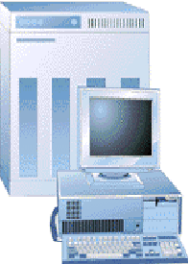
Role of the Operating System
Application
software
Operating
and
Systems
Software
Users
Hardware

Slide 11
Operating System Functions
An operating system is primarily a resource manager
  Design is tied to the hardware and software resources the operating system must manage
Perform common computer hardware functions
  Ex: Get input from keyboard
Provide a user interface
  Command-based user interface (ms-dos)
  Graphical-user interface (windows)
Provide a degree of hardware independence
  Application program interface
Manage system memory
  Convert logical view to physical view

Slide 12
Operating System Functions
Manage processing tasks
  Allocate computer resources
  Multitasking (run more than once application at a time)
  Time-sharing (allow multiple access to a system)
Provide networking capability
  Enable connection to the Internet
Control access to system resources
  Authentication
Manage files
  Access to files

Slide 13
  Perform common computer hardware functions:
    Processors, secondary storage (such as hard disks), other I/O devices, processes, threads, databases
  Provide a user interface
  Provide a degree of hardware independence
  Manage system memory
  Manage processing tasks
  Provide networking capability
  Control access to system resources
  Manage files

Slide 14
Types of Operating Systems
Today’s computers are:
  Multi-user - A multi-user operating system allows for multiple users to use the same computer at the same time and different times.
  Multiprocessing - An operating system capable of supporting and utilizing more than one computer processor.
  Multitasking - An operating system that is capable of allowing multiple software processes to run at the same time.
  Multithreading - Operating systems that allow different parts of a software program to run concurrently.

Slide 15
Programs
Programs are written in programming languages
  PL = programming language
  Pieces of the same program can be written in different PLs
    Languages closer to the machine can be more efficient
    As long as they agree on how to communicate
A PL is
  A special purpose and limited language
  A set of rules and symbols used to construct a computer program
  A language used to interact with the computer

Slide 16
Language Translators
A programming language (PL) is a vocabulary and set of grammatical rules for instructing a computer or computing device to perform specific tasks.
PL refers to high-level languages, such as BASIC, C, C++, COBOL, Java, FORTRAN, Ada, and Pascal.
Each PL has a unique set of keywords (words that it understands) and a special syntax for organizing program instructions.
A programmers uses PL to develop software programs, scripts, or other sets of instructions for computers to execute.
PL share similarities, each has its own syntax.

Slide 17
Language Translators
A programmer learns the languages rules, syntax, and structure, they write the source code in a text editor or IDE.
The programmer often compiles the code into machine language that can be understood by the computer.
Scripting languages, which do not require a compiler, use an interpreter to execute the script.

Slide 18
Assemblers
An assembler is a program that converts assembly language into machine code.
It takes the basic commands and operations from assembly code and converts them into binary code that can be recognized by a specific type of processor.
Assemblers are similar to compilers in that they produce executable code.
However, assemblers are more simplistic since they only convert low-level code (assembly language) to machine code.

Slide 19
Compilation into Assembly Language
Assembly Language
Source
Program
Compiler
Machine
Language
Assembly Language
Assembler
Notes:
Instead of to ML
Facilitates debugging
Isolates compiler from changes in format of ML (new OS)
Only assembler must be changed!

Slide 20
Compilers
A compiler is a software program that transforms high-level source code that is written by a developer in a high-level programming language into a low level object code (binary code) in machine language, which can be understood by the processor.
The process of converting high-level programming into machine language is known as compilation.
The processor executes object code, which indicates when binary high and low signals are required in the arithmetic logic unit of the processor.
The stages in compilation include:
Lexical Analysis
Syntax Analysis
Semantic Analysis
Intermediate code generation
Code optimization
Code generation

Slide 21
Compiler
  A program that converts another program from some source language (or high-level programming language / HLL) to machine language (object code).
  Some compilers output assembly language which is then converted to machine language by a separate assembler.
  Is distinguished from an assembler by the fact that each input statement, in general, correspond to more than one machine instruction.

Slide 22
Compilation
Source
Program
Compiler
Target
Program
Input
Target Program
Output
Compiler translates source into target (a machine language program)
Compiler goes away at execution time
Compiler is itself a machine language program, presumably created by compiling some other high-level program
Machine language, when written in a format understood by the OS is object code

Slide 23
Interpreters
An interpreter is a computer program that is used to directly execute program instructions written using one of the many high-level programming languages.
The interpreter transforms the high-level program into an intermediate language that it then executes, or it could parse the high-level source code and then performs the commands directly, which is done line by line or statement by statement.
Programming languages are implemented in two ways:
interpretation and compilation.

Slide 24
Interpreters
An interpreter transforms or interprets a high-level programming code into code that can be understood by the machine (machine code) or into an intermediate language that can be easily executed as well.
The interpreter reads each statement of code and then converts or executes it directly.
In contrast, an assembler or a compiler converts a high-level source code into native (compiled) code that can be executed directly by the operating system.

Slide 25
Interpretation
Source
Program
Interpreter
Output
Input
The interpreter stays around during execution
It reads and executes statements one at a time

Slide 26
Compilation vs. Interpretation
Compilation:
  Syntax errors caught before running the program
  Better performance
  Decisions made once, at compile time
Interpretation:
  Better diagnostics (error messages)
  More flexibility
  Supports late binding (delaying decisions about program implementation until runtime)
    Can better cope with PLs where type and size of variables depend on input
  Supports creation/modification of program code on the fly (e.g. Lisp, Prolog)

Slide 27
Mixture of C & I
Source
Program
Translator
Intermediate
Program
Intermediate
Program
VM
Output
Input
Many programming languages implement this
Interpreter implements a Virtual Machine (VM).

Slide 28
JAVA
  For portability:
Java
Compiler
bytecode
ML
Interpreter
  For flexibility: Just In Time (JIT) compiler translates bytecode into ML just before execution

Slide 29
Utility Software
  It helps you maintain your computer and keep it in good running condition
  Utility software is software designed to help to analyse, configure, optimize or maintain a computer.
  It is used to support the computer infrastructure - in contrast to application software, which is aimed at directly performing tasks that benefit ordinary users.
  Utilities often form part of application systems.
  For example a batch job may run user-written code to update a database and may then include a step that runs a utility to back up the database, or a job may run a utility to compress a disk before copying files.

Slide 30
File Conversion
File conversion is the process of converting a file into another type.
For example:
transferring a file used in Microsoft Word to Corel Word Perfect.
It overs data transfer from any medium to another medium, making an exact copy or simultaneously editing and Validating data.
a copy from a hard disk to a diskette.
File Copy
File copying is the creation of a new file which has the same content as an existing file.
For example:
File copying is the creation of a new copy file which has the same content as an existing file.
Housekeeping Operations
These include programs to clear areas of storage, writing file labels, updating common data e.g. data.

Slide 31
Application Software
  Programs that help users solve particular computing problems
  Programs written for computer users and it enables you to perform specific computer tasks, such as document production, spreadsheet calculations, and database management
    Word-processors, spreadsheets, & other application packages
  Software that can perform a specific task for the user, such as
Word processors– example: Microsoft word
Spreadsheets-- example: Microsoft Excel
Database managers-- example: Microsoft Access
Graphics-- example: Photoshop
  Application Software – Basic Tools: Examples
  word processing, accounting, budgeting or payroll, fall under the category of application software. Word processors, spreadsheets, database management systems are all examples of general purpose application software

Slide 32
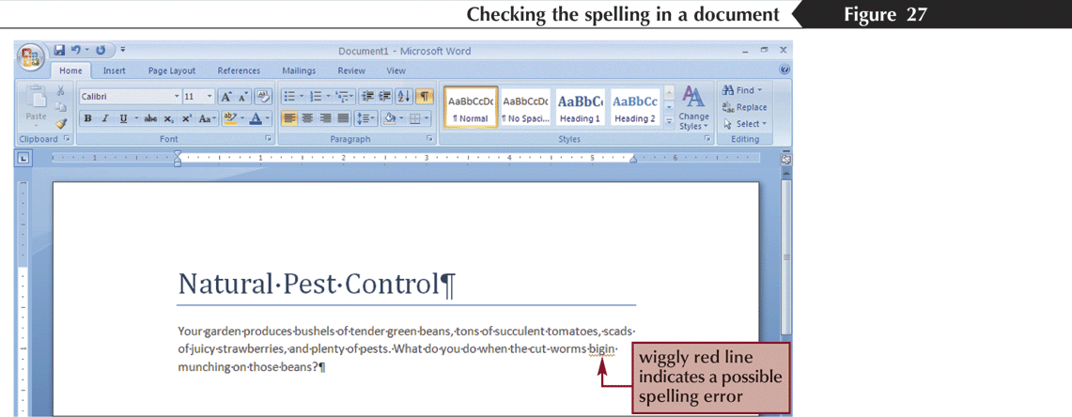
  Word processing software:
  The main purpose of this software is to produce documents.
  MS-Word, Word Pad, Notepad and some other text editors are some of the examples of word processing software

Slide 33
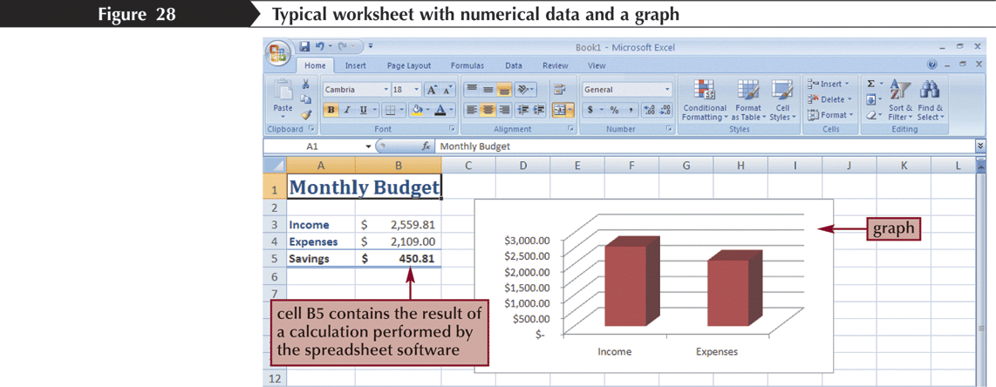
  Spread sheet software:
  The spread sheet software is used to maintain budget, financial statements, grade sheets, and sales records.
  The purpose of this software is organizing numbers.
  It also allows the users to perform simple or complex calculations on the numbers entered in rows and columns.
  MS-Excel is one of the example of spreadsheet software.

Slide 34
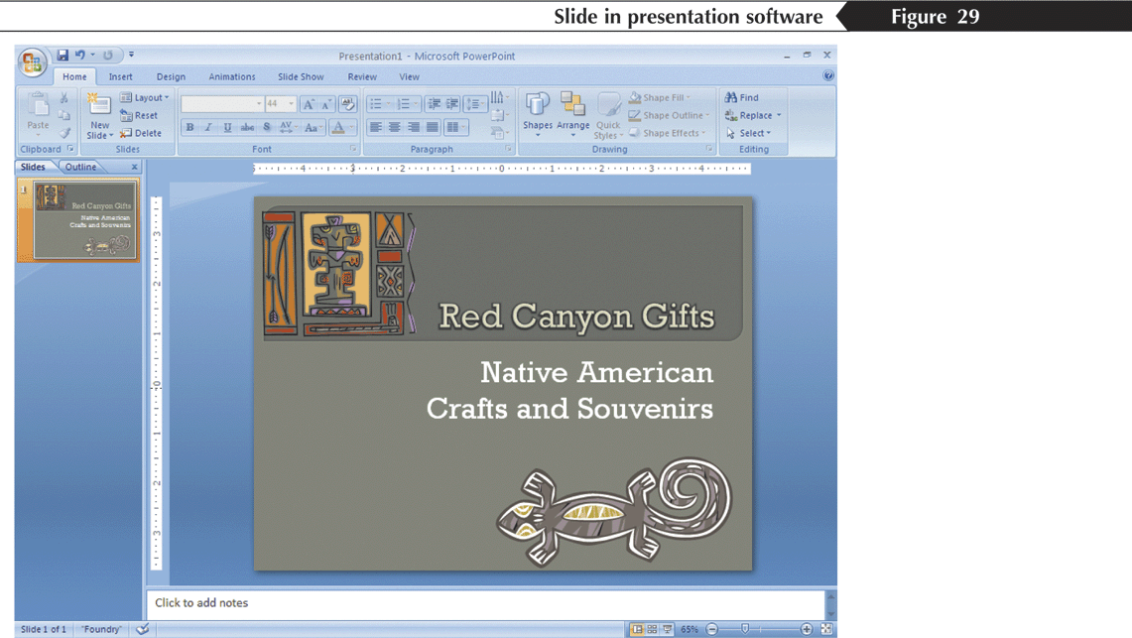
Presentation software:
This software is used to display the information in the form of slide show.
The three main functions of presentation software is editing that allows insertion and formatting of text, including graphics in the text and executing the slide shows.
The best example for this type of application software is Microsoft PowerPoint.

Slide 35
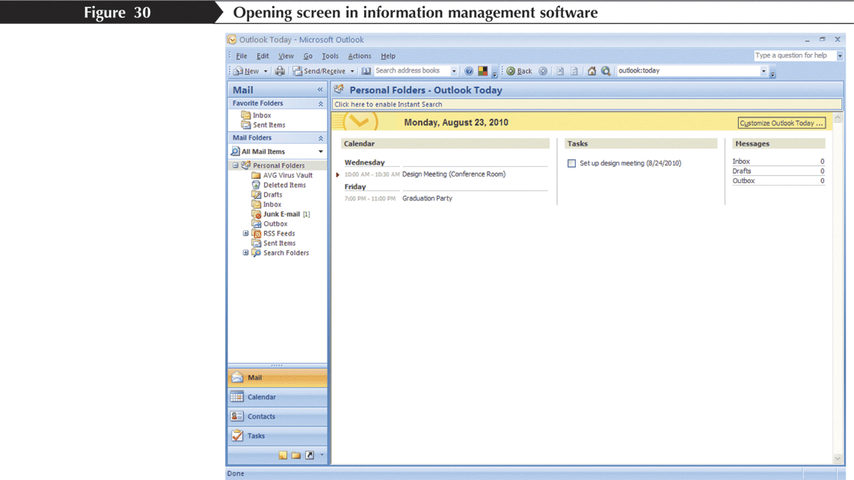
Multimedia software:
Media players and real players are the examples of multimedia software.
This software will allow the user to create audio and videos.
The different forms of multimedia software are audio converters, players, burners, video encoders and decoders.

